Slide 1
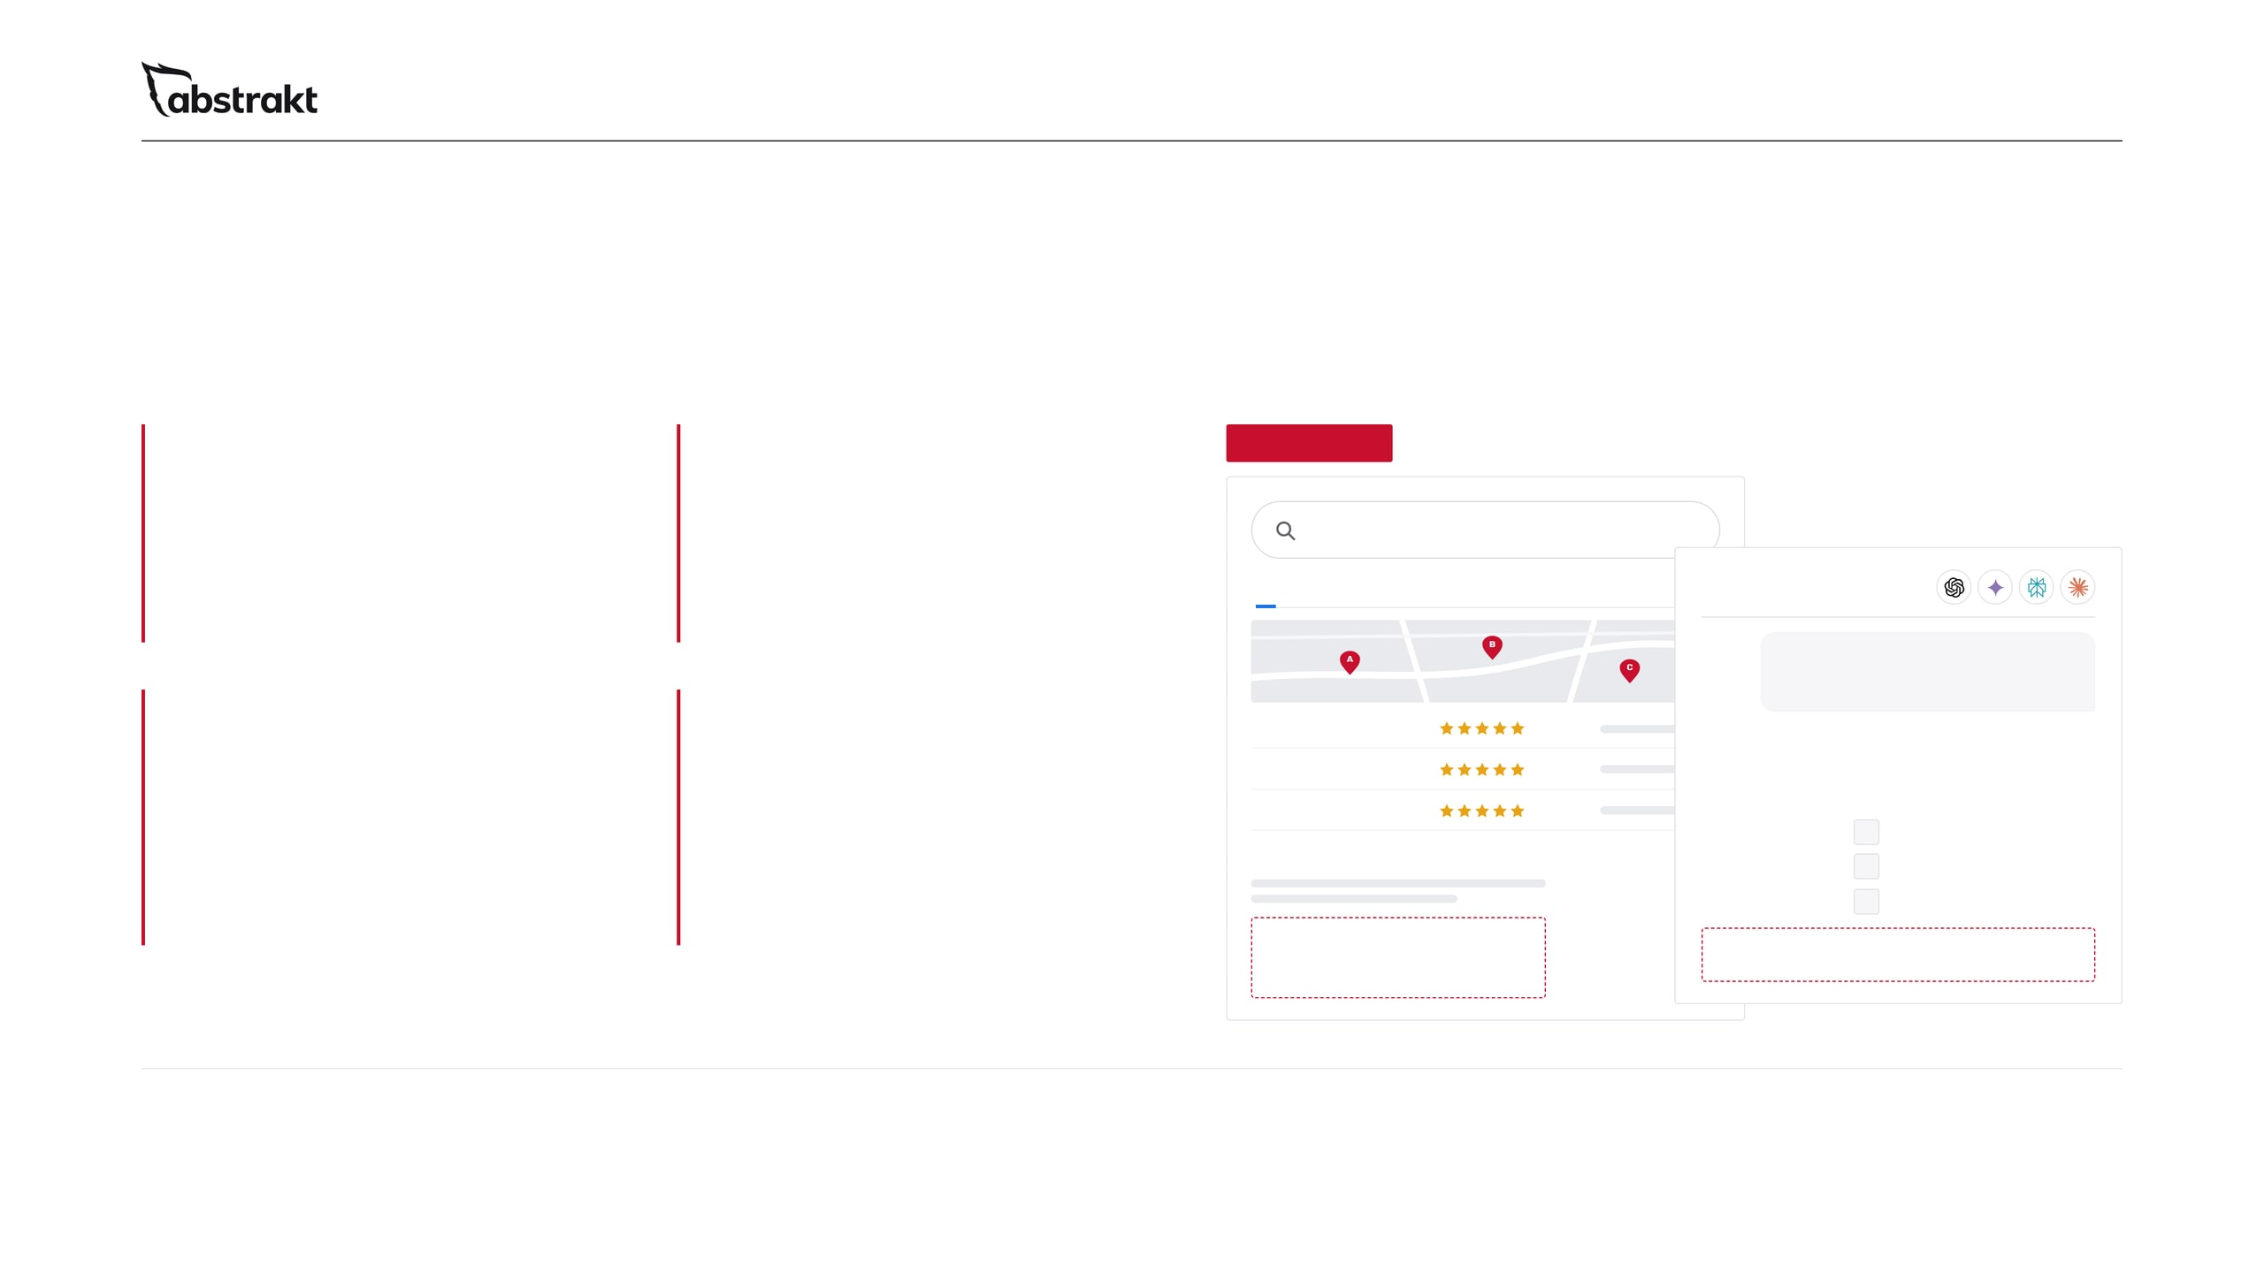
01 / 11 · THE PROBLEM
Your next customer is searching.
Are they finding you?
01
02
ILLUSTRATION
Invisible on Google
Missing from AI answers
Buyers search for the service and the problem, not your company name. If no page of yours answers that search, a competitor's page does.
ChatGPT, Gemini, Perplexity and Google's AI Overviews answer from pages they can crawl and understand. A thin site gives them nothing to describe.
commercial roofing contractor near me
All
Maps
Images
News
AI ANSWER
Which commercial roofing contractors near me should I call?
03
04
Competitor A
Weak local presence
A website that doesn't work hard enough
Based on their websites, reviews and Business Profiles, three companies stand out for commercial work in your area:
Google often shows a map of local companies before the regular results. An incomplete Business Profile with few reviews is easy to pass over.
Competitor B
A buyer who finds you decides quickly whether to reach out. Without proof and one clear next step on every page, the visit ends there.
Competitor C
Competitor A
1
Roofing Services | Competitor B
Competitor B
2
Competitor C
3
Your company
Your company: not mentioned
Not on the first page
68%
If customers can't find you, they can't buy from you.
of US Google searches ended without a click to any website.
Notes:
Open with the buyer, not with us. Every commercial buyer checks you out online before they reach out or agree to an appointment, and more of them now ask an AI assistant first. Walk through the four places a company loses that buyer: it doesn't show up for the search, the AI answer doesn't mention it, the map shows competitors, or the website gives no reason to call. The 68% figure is SparkToro's, from Similarweb data on US searches, January to April 2026: most searches end on the results page, so what shows there matters. Ask: when you search for your own service in your area, who comes up?

Slide 2
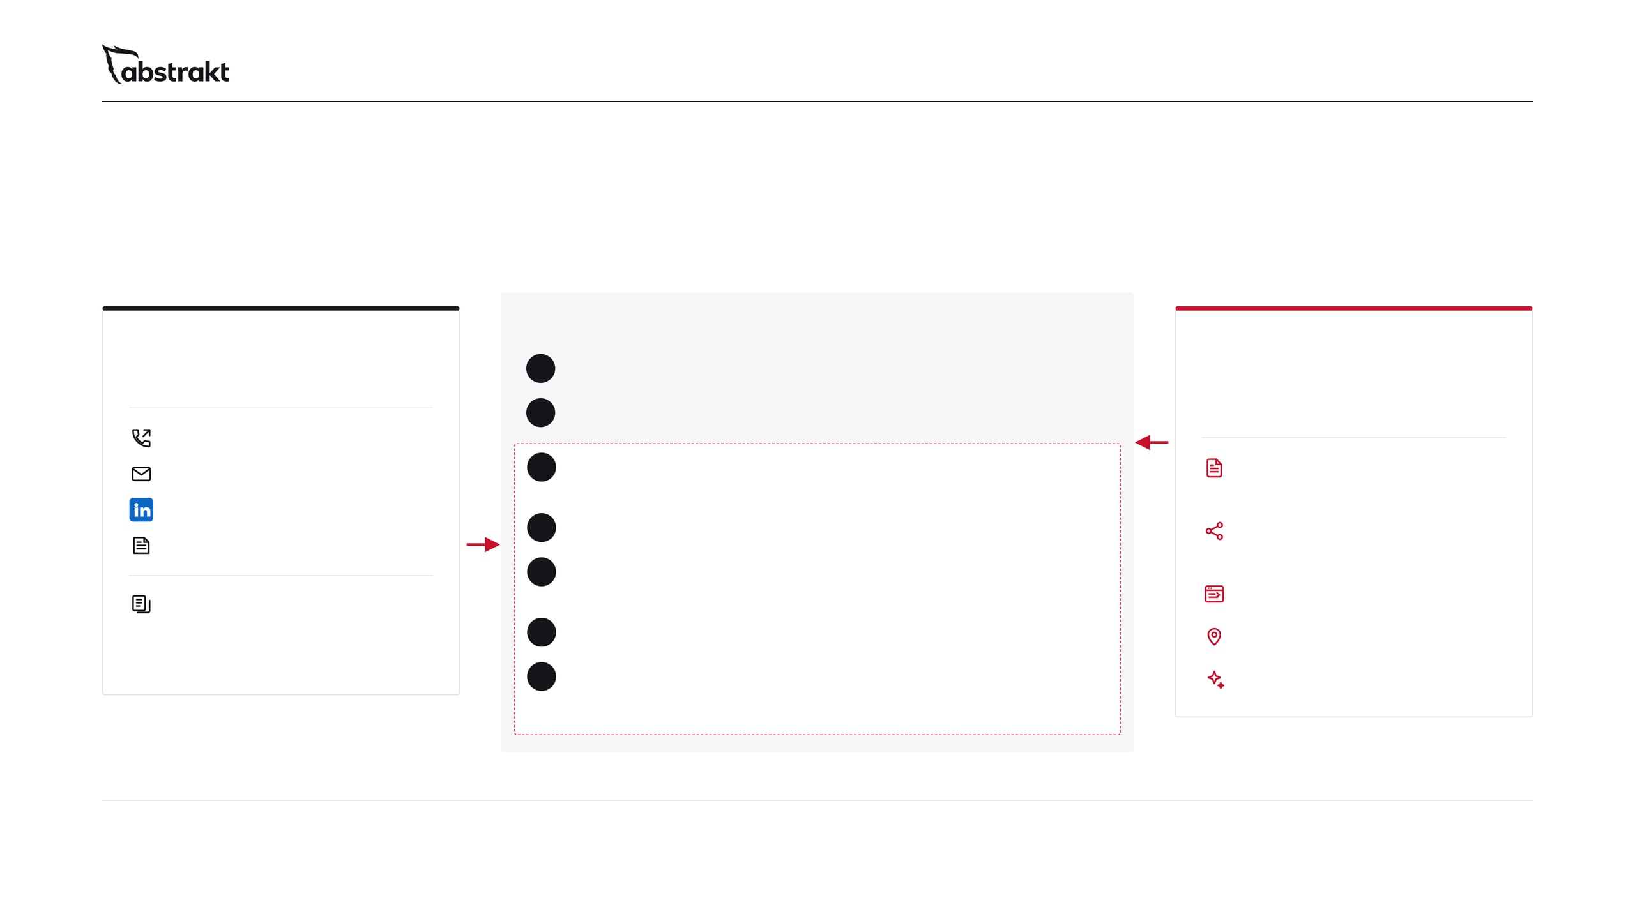
02 / 11 · BETTER TOGETHER
Two engines.
One pipeline.
The fuel loop
OUTBOUND BDR
A new blog every business day
INBOUND SDR
Starts the conversation
1
Written from the questions your buyers ask
INBOUND SDR
Gives every touch something to land on
2
Posted to up to 3 social platforms
INBOUND SDR
Calls every working day
Chosen from LinkedIn, Facebook, Instagram, TikTok, YouTube and X
Short, text-only emails
3
Your new connections see it
BOTH
A blog every business day
The buyers your SDRs connect with see your posts in their feed between touches
Posted to up to 3 social platforms, chosen from LinkedIn, Facebook, Instagram, TikTok, YouTube and X
LinkedIn connections
The buyer recognizes you
Direct mail
4
When your SDR calls again, the name is familiar
OUTBOUND BDR
5
They look you up, and we see the visit
BOTH
When a buyer asks for more information, your SDRs have a growing library of your content to share, and they call the companies that visit your site.
Your site and AI answers back it up; visitor identification flags the company for your SDR
Your website, up to 100 pages
6
The appointment holds
BOTH
Local SEO and your Business Profile
The buyer already knows what you do
7
Not now? They keep seeing you
INBOUND SDR
Visibility in AI search
Your posts stay in their feed until the timing is right
↺ Back to step 3 until they are ready
Run both for the best chance at a predictable pipeline.
Notes:
This is the slide for anyone running outbound, or thinking about it. Two engines. On the left, Outbound BDR starts the conversation: calls every working day, short emails, LinkedIn connections and direct mail. On the right, Inbound SDR gives every one of those touches something to land on: a blog every business day posted to up to 3 social platforms, chosen from LinkedIn, Facebook, Instagram, TikTok, YouTube and X, the website, local SEO and visibility in AI search. In the middle is the fuel loop. Every business day a new blog goes out and is posted to up to 3 social platforms, chosen from LinkedIn, Facebook, Instagram, TikTok, YouTube and X. The buyers your SDRs connect with see those posts in their feed between touches, so when the SDR calls again the name is familiar. When they look you up, your site, Business Profile and AI answers back it up, and because we run the website, visitor identification shows us the company, so your SDR can call while the interest is fresh. The appointment holds. The "not now" buyers keep seeing your posts until the timing is right. And when a buyer asks for more information, there is a library of content we have been building for them, so they have more to say and come across as the expert on what they sell, ahead of the competition. No promises on numbers; this is simply how the two work together. Ask: when your SDR connects with a buyer on LinkedIn, what do they see in their feed the next day?

Slide 3
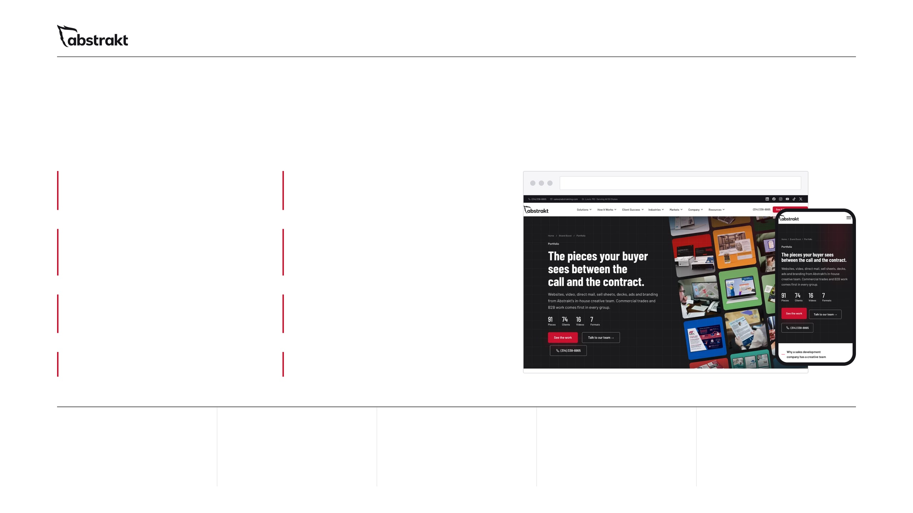
03 / 11 · THE COMPLETE PROGRAM
Everything you need to compete online.
One complete program.
A website built to sell
Local SEO and your Google Business Profile
abstraktmg.com
UP TO 100 PAGES
MANAGED FOR YOU
A new blog every business day
Every blog posted to up to 3 social platforms
EVERY BUSINESS DAY
CHOSEN FROM LINKEDIN, FACEBOOK, INSTAGRAM, TIKTOK, YOUTUBE AND X
2 to 3 expert hours a month
Monthly reporting and strategist access
EVERY MONTH
ANY TIME YOU ASK
One white paper
A guide for every product or service
TO START
ONE PER SERVICE
Our portfolio page on abstraktmg.com, built on Astro, the same framework in the program's stack.
UP TO
UP TO
100
20+
3
2 to 3
Monthly
page website
blogs a month, one every business day
social platforms every blog is posted to, chosen from six
hours a month of technical and page work
reporting, plus a strategist when you need one
Notes:
This is the whole program on one page. From the starting price you get a website of up to 100 pages; local SEO and your Google Business Profile managed for you; a new blog every business day, published on your site and posted to up to 3 social platforms, chosen from LinkedIn, Facebook, Instagram, TikTok, YouTube and X; 2 to 3 expert hours a month for technical adjustments and fixes, page adjustments, or additional guides and white papers; monthly reporting, reviewed with your dedicated strategist; one white paper to start; and a guide for every product or service. The screens are our own site, built on the same framework the program uses. Scope depends on the size of the site, the number of markets and the content you need.

Slide 4
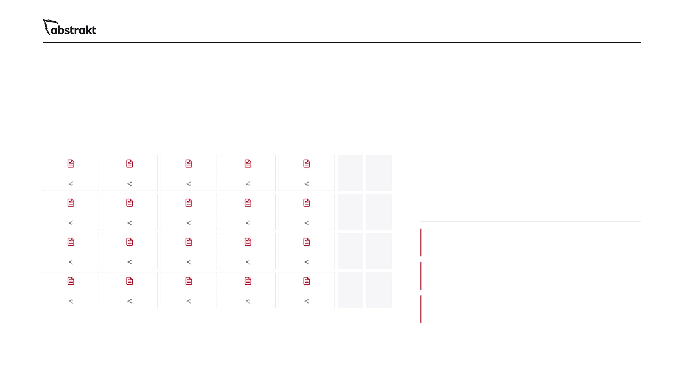
04 / 11 · WHAT A MONTH LOOKS LIKE
Every business day, something new goes out.
Here is one month.
A MONTH OF BUSINESS DAYS
20+
MON
TUE
WED
THU
FRI
SAT
SUN
New blog
New blog
New blog
New blog
New blog
blogs a month
One every business day. A month has 20 to 23 business days, and every blog is posted to up to 3 social platforms, chosen from LinkedIn, Facebook, Instagram, TikTok, YouTube and X.
New blog
New blog
New blog
New blog
New blog
2 to 3 expert hours
Technical adjustments and fixes, page adjustments, or additional guides and white papers.
New blog
New blog
New blog
New blog
New blog
Local SEO, checked and corrected
Business Profile, Bing Places and 65+ directory listings kept accurate through directory submissions and updates.
New blog
New blog
New blog
New blog
New blog
Monthly reporting
Rankings, traffic and leads, reported every month, with a strategist to call whenever you have questions.
No waiting for someone to find the time. Yours goes out every business day.
Notes:
This is what the monthly fee buys. We build the website in the first month; from month 2, every month looks like this. Every business day we write a blog for your buyers, publish it on your site and post it to up to 3 social platforms, chosen from LinkedIn, Facebook, Instagram, TikTok, YouTube and X: a month has 20 to 23 business days, so that is 20-plus blogs a month. On top of that, 2 to 3 expert hours each month go to technical adjustments and fixes, page adjustments, or additional guides and white papers. Your Business Profile and listings are checked and corrected, and you get monthly reporting and a strategist whenever you have questions. Ask: how often does your company publish today?

Slide 5
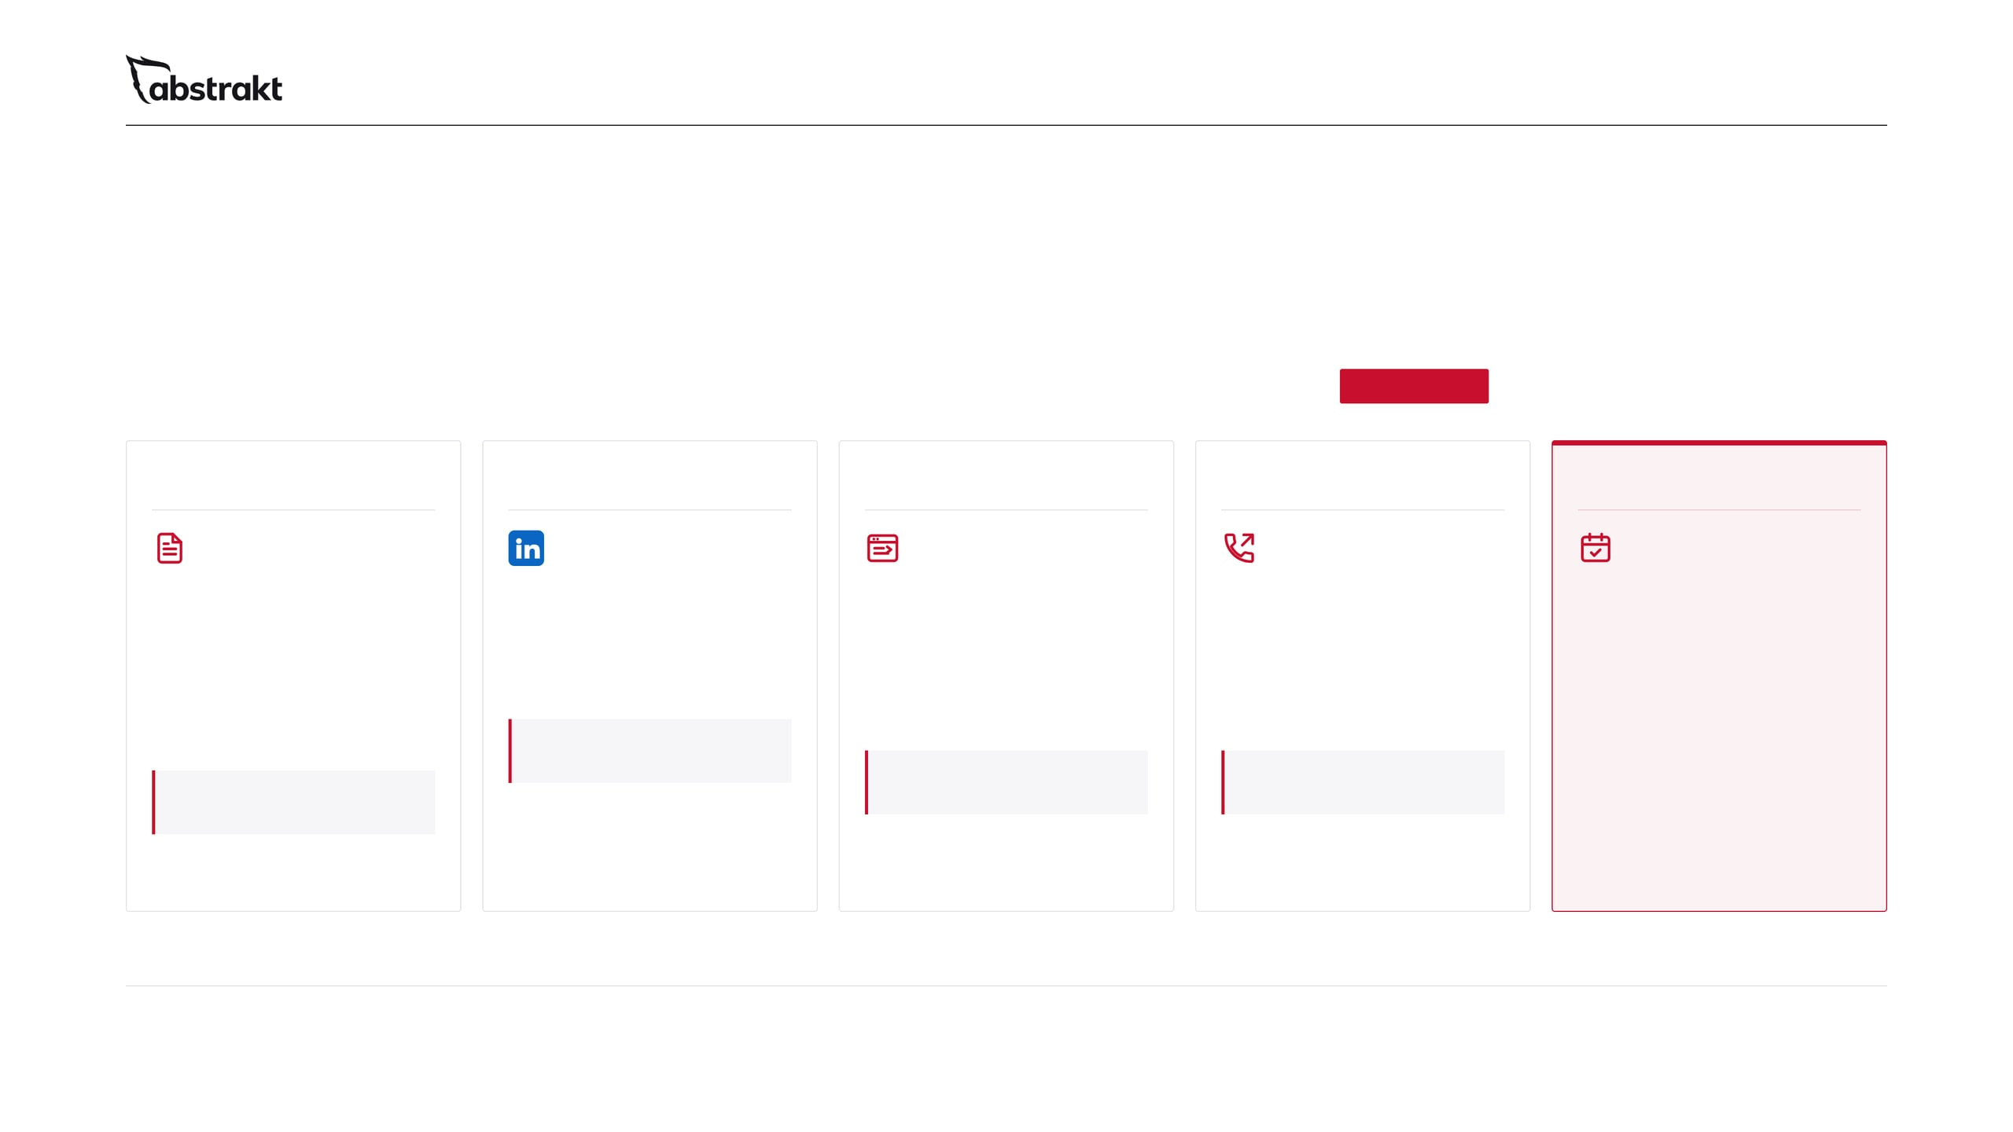
05 / 11 · A DAY IN THE LIFE
One business day.
Both engines running.
How Inbound SDR and Outbound BDR connect on an ordinary day.
ILLUSTRATION
Example: A commercial services company
8:00 AM
9:30 AM
11:00 AM
11:15 AM
2:00 PM
Today's blog goes live
A new connection sees it
Their company visits and downloads a guide
Your SDR calls while the interest is fresh
Appointment booked
Published on your site and posted to up to 3 social platforms, chosen from LinkedIn, Facebook, Instagram, TikTok, YouTube and X.
Someone your SDR connected with this week sees the post in their feed.
Qualified and sent to your calendar like every outbound appointment, with the trail in your Results Portal.
They read the post on your site and download a guide. Visitor identification flags the company.
Not a cold call: the buyer knows your name, and your SDR has a reason to call.
Facility director, Commercial property owners
Today: What to ask before you choose a new service provider
Downloaded: your buyer's guide to your main service
Trigger: A contract coming up for renewal
Not every day ends with an appointment. Every business day gives the next buyer a reason to look.
Notes:
Make the two engines concrete with one ordinary day. In the morning a new blog goes live on the client's site and is posted to up to 3 social platforms, chosen from LinkedIn, Facebook, Instagram, TikTok, YouTube and X. A buyer the SDR connected with on LinkedIn sees it in their feed, visits the site and downloads a guide; because we run the website, visitor identification flags the company and the download shows someone raised a hand. The SDR calls while the interest is fresh, with a reason to call, and books a qualified appointment that goes to the client's calendar and the Results Portal. Say clearly that the times and names are an illustration, not a promise of timing or results. Ask: what happens today when a buyer downloads something from your website?

Slide 6
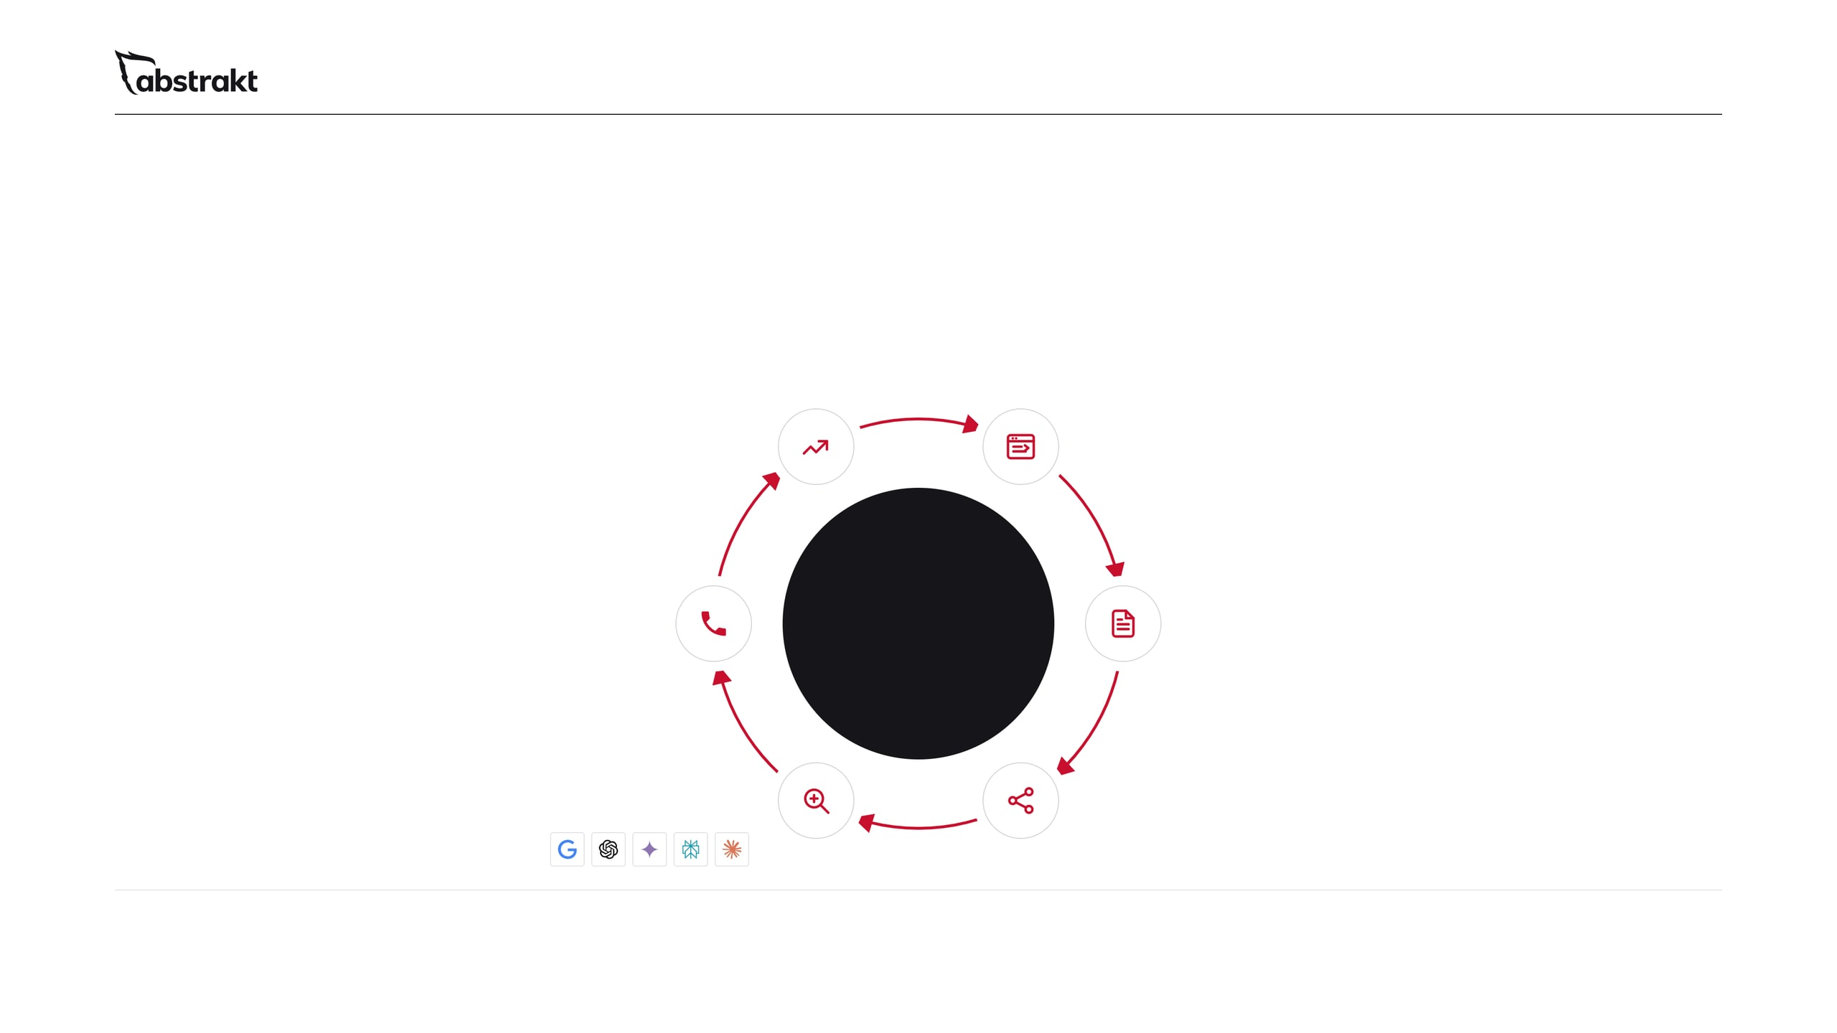
06 / 11 · THE DAILY GROWTH ENGINE
The website is the engine.
Daily activity is the gas.
06 Continuous improvement
01 Website
Monthly reporting shows what brings inquiries. The next month's work follows it.
Where every channel ends up. Built so a visit can become an inquiry.
Every business day
05 Traffic and inquiries
A new blog goes out to your site and up to 3 social platforms, chosen from LinkedIn, Facebook, Instagram, TikTok, YouTube and X.
02 A blog every business day
Visits counted as traffic. Forms, tracked calls and appointments counted as leads.
Written for your buyers and published on your site, plus 2 to 3 expert hours a month on technical fixes and page adjustments.
04 Google and AI discovery
More pages that answer real questions give search engines and AI tools more to find and cite.
03 Posted to up to 3 social platforms
Every blog goes to the social pages buyers check.
We don't just build your digital presence. We work on it every day.
Shares and likes are not a direct Google ranking factor, and no one can guarantee a ranking or an AI citation. We do not. Social builds branded searches, links, mentions and a consistent identity; AI assistants read public pages and posts directly.
Notes:
This is why the price is monthly and not a one-time build. We build the website in the first month, and the daily work starts from there. The website is the engine, and daily activity is what moves it. Every business day a new blog is written, published and posted to up to 3 social platforms, chosen from LinkedIn, Facebook, Instagram, TikTok, YouTube and X, and more pages that answer real questions give Google and the AI assistants more to work with. Be precise here: social posts are not a direct ranking factor, and nobody can promise a ranking or an AI citation. What we control is whether your site gives them a clear, accurate, crawlable reason to show you. Search builds over months: initial results in one to three months, noticeable improvement in three to six, full results in six to twelve months or more.

Slide 7
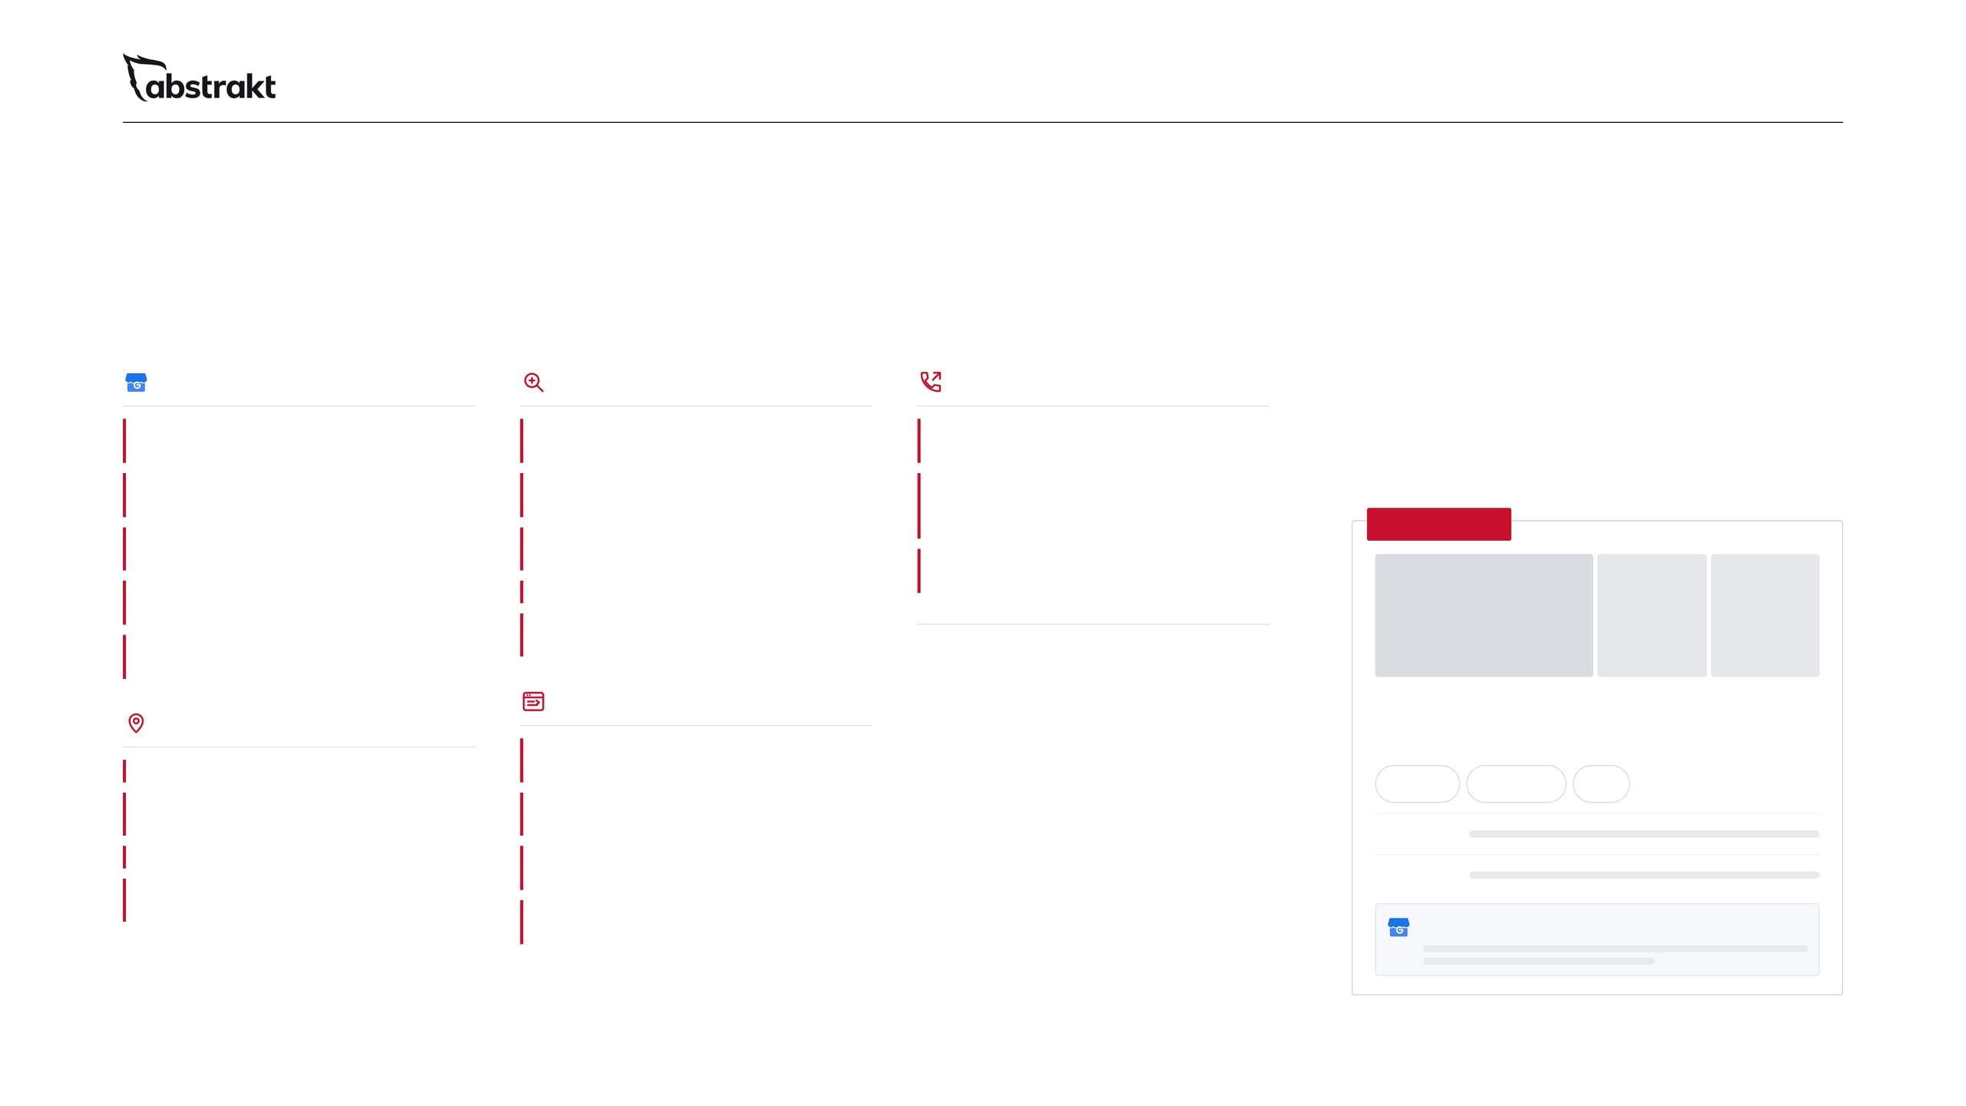
07 / 11 · LOCAL SEO
Be the company they find nearby.
Here is everything we manage.
Google Business Profile
Research and local content
Tracking
When a buyer searches for your service near them, Google often shows a map of local companies first. Local SEO is the work that puts an accurate, complete profile of your company there, and keeps it right every month.
Verified, with ownership kept in your company's name
An audit of your citations, listings and Business Profile for accuracy
Calls, direction requests and website clicks from your profile
Primary and secondary categories matched to the services you sell
Competitor rankings, keywords and backlink profiles
Form submissions, and calls where call tracking is set up, sent to your CRM for follow-up
Services, service areas, hours and special hours kept current
Geo-specific keywords: your service near the buyer
ILLUSTRATION
Monthly reporting on rankings and leads, in the Partner Results Portal
Photos of real jobs, crews and equipment added through the year
Locally focused content and local link building
A business description written for the buyers you sell to
Directory submissions and updates, so your Business Profile details match everywhere
Reviews come from your customers. We do not request, monitor or respond to them.
Listings everywhere else
On your website
Your company
A service-area page where you have real work and something specific to say
Commercial roofing contractor
Bing Places for Business set up and optimized
Website
Directions
Call
Name, address and phone consistent across 65+ directories
Local business schema that matches the name, address and phone on the page
Hours
Duplicate listings found and suppressed
The same contact details on the site, the profile and every listing
Services
Listings monitored so a wrong number or old address gets fixed
Site speed, mobile layout and Core Web Vitals checked
Details updated across directories
Notes:
Local is where a commercial buyer checks you out first, often right after a sales call. Walk through the checklist: the Business Profile verified in your name with the right categories, services, service areas, hours and job photos; Bing Places and 65-plus directories kept consistent, with duplicates suppressed; an audit, competitor and geo-keyword research, local content and local link building; service-area pages and local schema on your site; and tracking of calls, direction requests and clicks, reported monthly. Be clear that reviews come from their customers: we do not manage, request or respond to reviews.

Slide 8
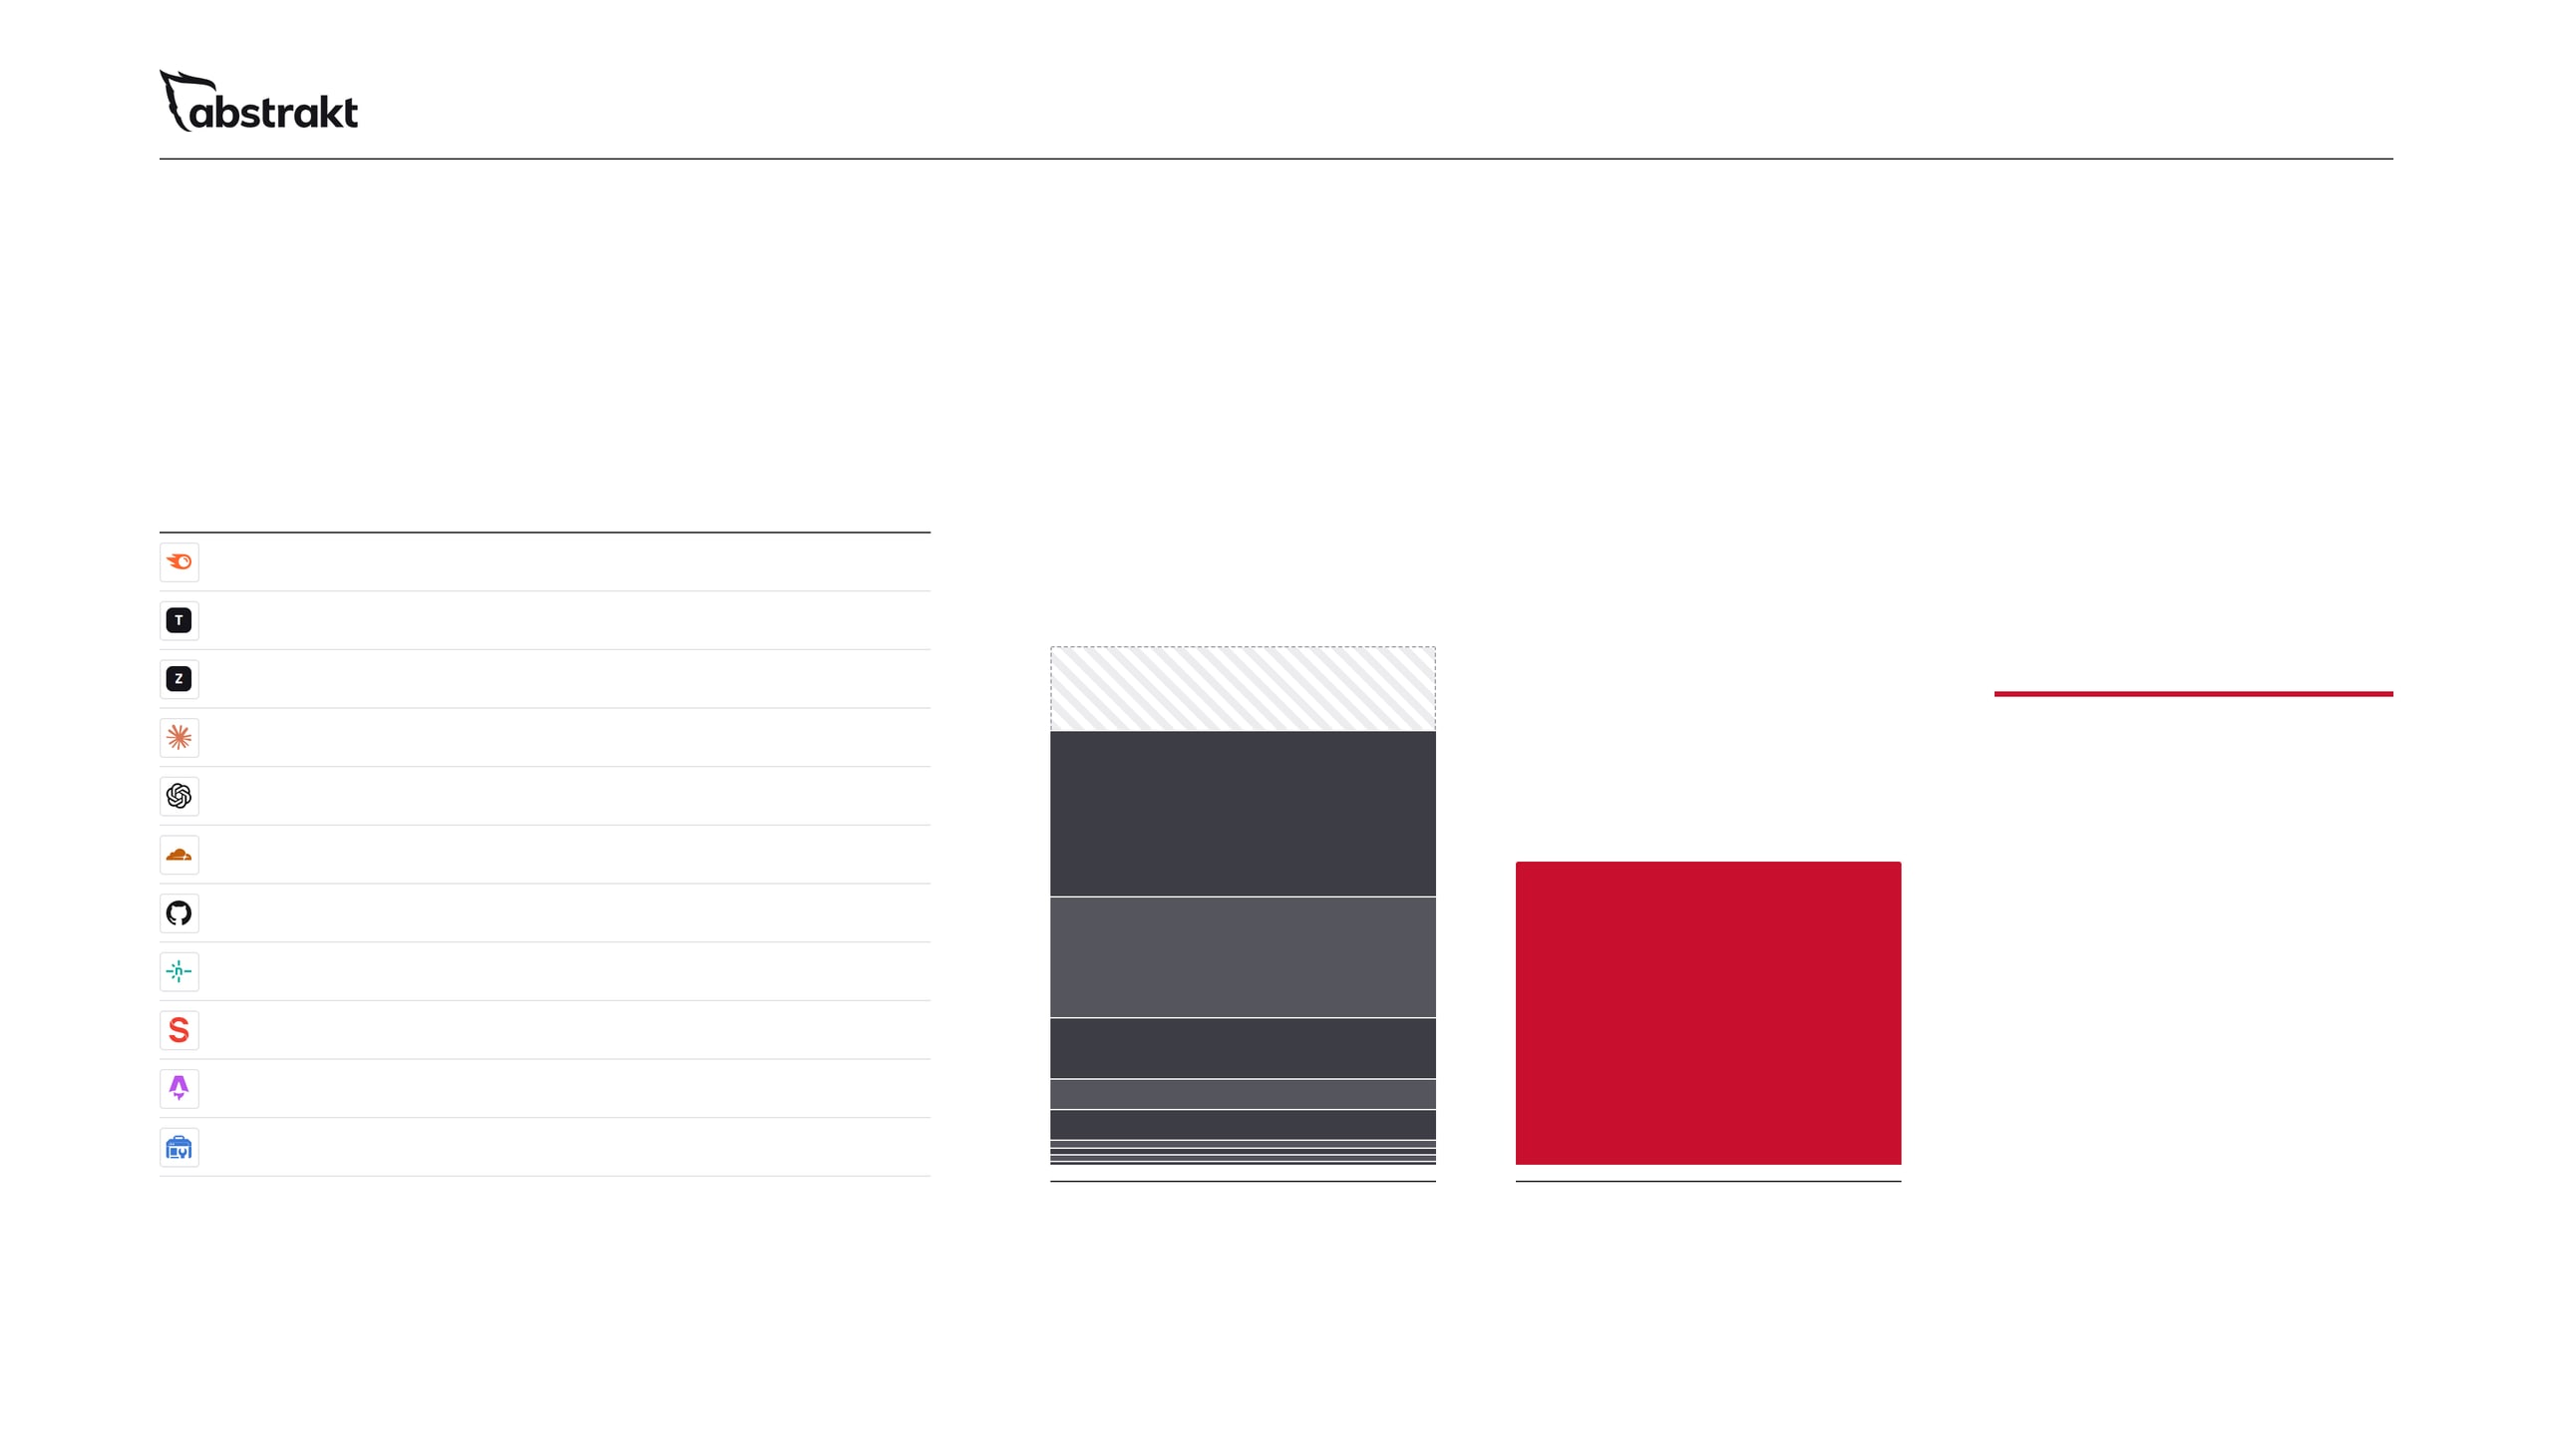
08 / 11 · THE MATH
The software alone costs more
than the whole program.
THE SOFTWARE STACK, BOUGHT YOURSELF
$1,427
Semrush
Advanced
$549
Tavus
Growth
$397
to $1,708 with two users
ZoomInfo
Website visitor tracking
$200
$100
$1,000
Claude
Max
And that's before the people.
ChatGPT
Pro
$100
Semrush
Pro
$25
starting price
Cloudflare
GitHub
Enterprise
$21
Netlify
Pro
$20
Tavus
$15
Software, people and daily work
→
Sanity
Growth
ZoomInfo
Astro
Open source
$0
Google Search Console
Free
$0
The software stack, bought yourself
Abstrakt Inbound SDR
a month, starting price, with the software, the people and the daily work included
a month in software alone, on the selected premium plans
Notes:
This is the slide to slow down on. On the left is the software behind the program, priced from each vendor's own pricing page: $1,427 a month for one user on the plans we selected, $1,708 with two users. On the right is the whole program, starting at $1,000 a month. The software alone costs more than we charge for everything, and that is before anyone writes a blog, fixes a page or manages a listing. Be fair about it: this is an illustrative premium configuration, not the minimum anyone could spend, and enterprise tiers are not included. ZoomInfo's figure is our quoted cost.

Slide 9
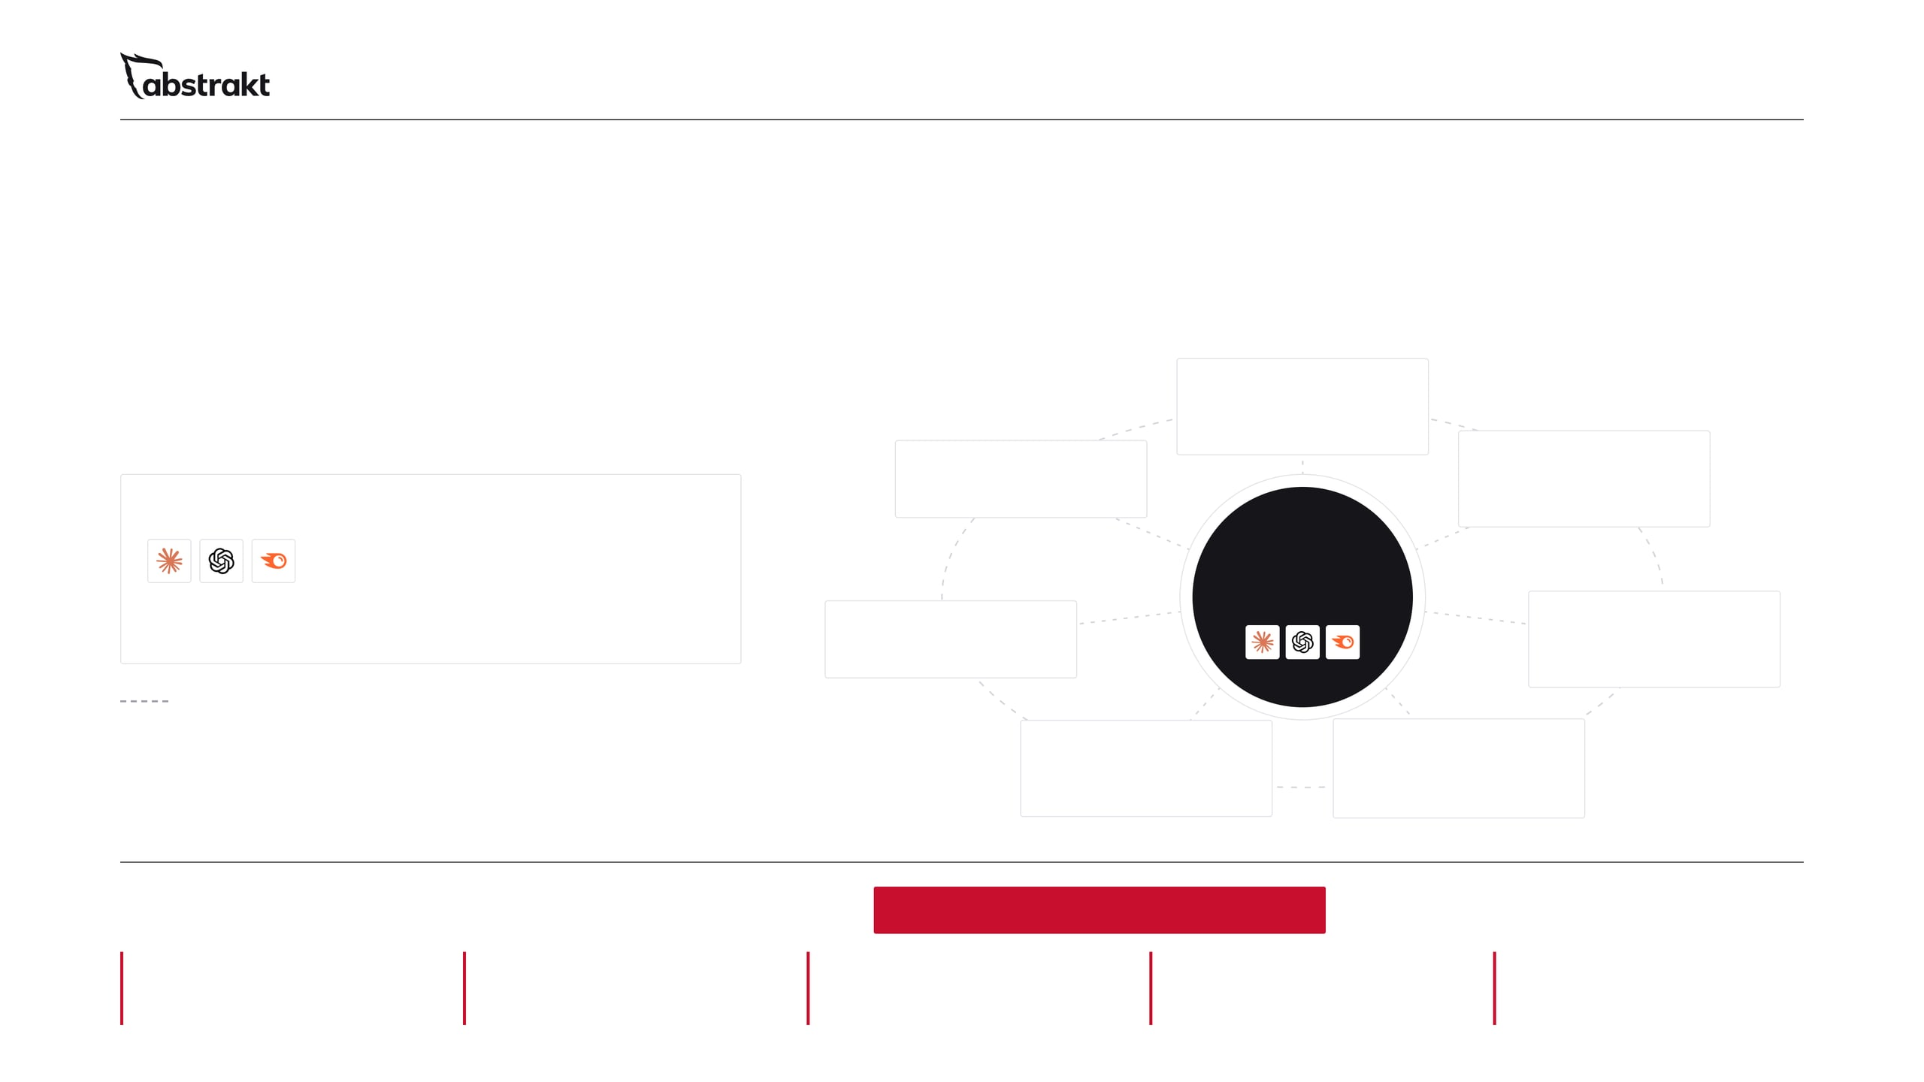
09 / 11 · THE PEOPLE
And that's before the people.
One dedicated strategist. Experts on call.
One dedicated strategist works on your account every business day and uses AI to do the work. When the work calls for it, they bring in our subject matter experts in each area below.
Project management
Plan the work and keep it moving
Graphic design
SEO
Social sets and visual assets
Keywords, on-page, local and technical SEO
AI IN THEIR HANDS
Your dedicated strategist
Claude and ChatGPT for research, outlining and editing support; Semrush for keyword, competitor and AI visibility research.
+ AI
Social media
AI search
Posts, calendar and distribution
Visibility in AI answers and AI Overviews
Subject matter experts they can call on
Writing and editing
Web design and development
Pages, blogs, guides and white papers
The site, its speed and its forms
Technology
+
Talent
+
Daily execution
One managed program
=
Scale
Processes
Tools
Experts on call
Operating model
One stack and one set of experts across many programs
Five steps, in the same order every time
Already set up and running
Skills you would not hire one at a time
Daily execution, measured monthly
Notes:
Software does nothing on its own. One dedicated strategist works on the client's account every business day and uses AI to do the work: Claude and ChatGPT for research, outlining and editing, Semrush for keyword and competitor research. That person is not on their own. When the work calls for it, they call on our subject matter experts in project management, SEO, AI search, web design and development, writing and editing, social media and graphic design. The experts work across client programs, so the client gets those skills without hiring any of them. Do not describe the experts as assigned to the account. That is the operating model: technology, talent and daily execution, as one managed program.

Slide 10
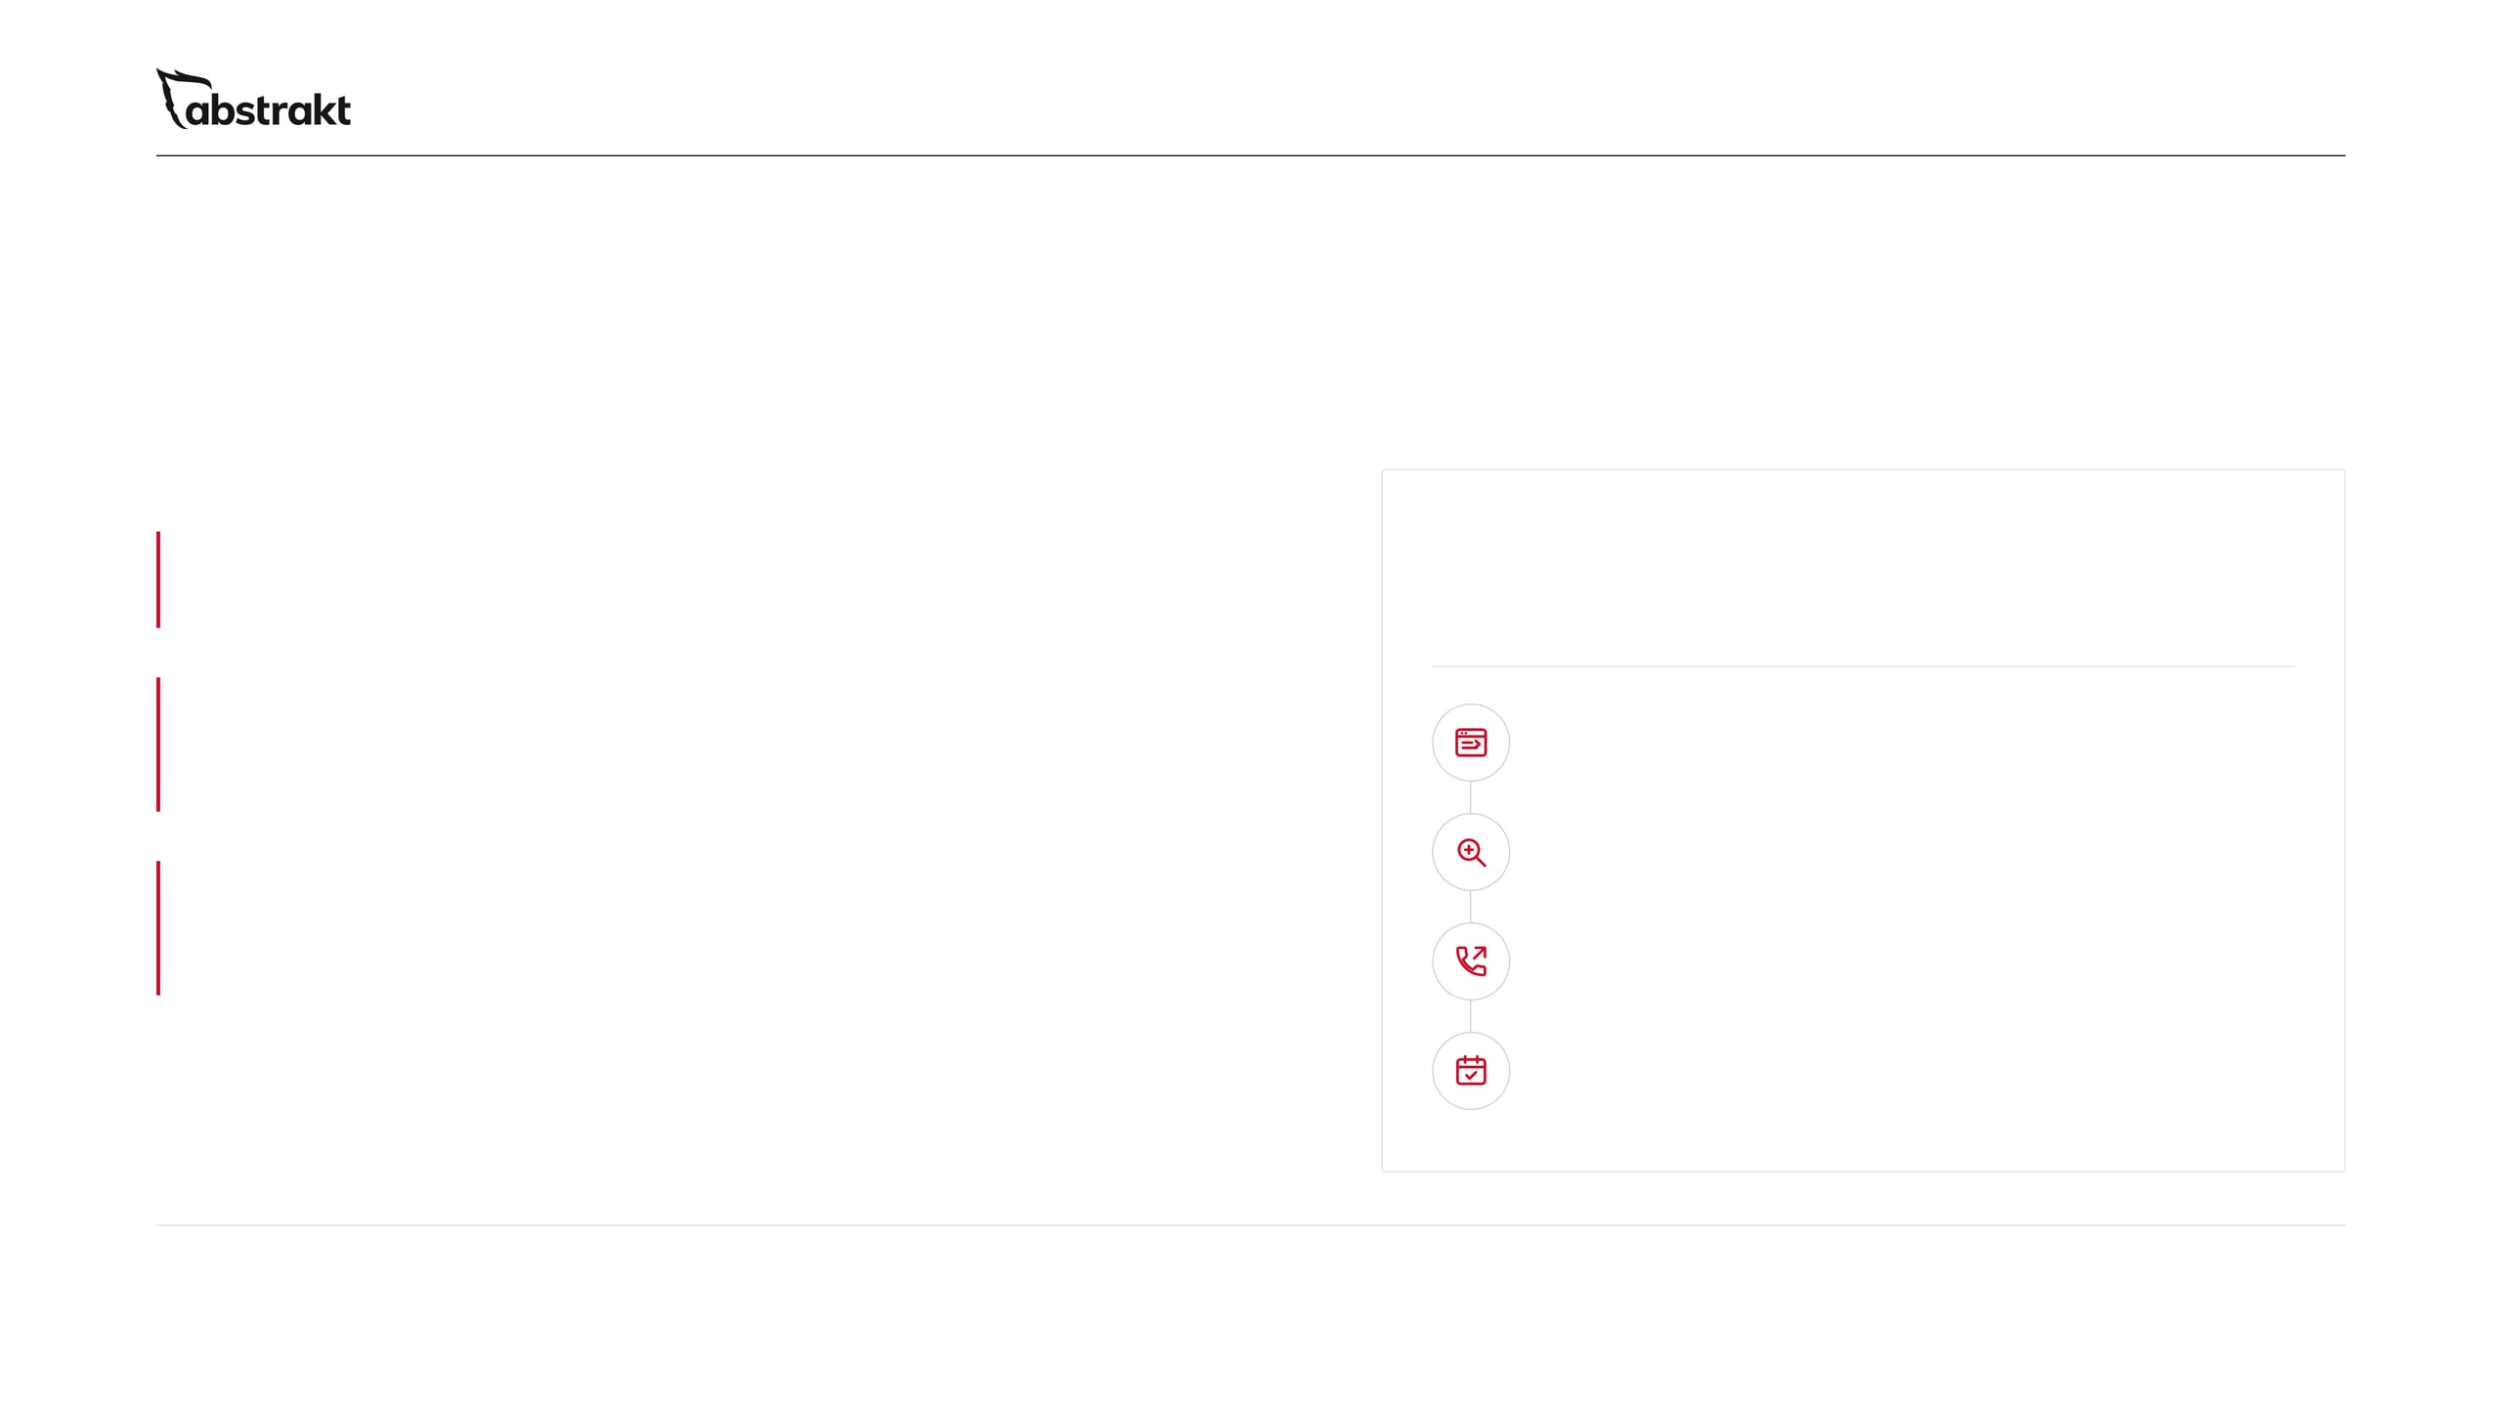
10 / 11 · RUN BOTH
Add inbound to outbound.
One team behind every lead.
WHY RUN BOTH
Outbound starts the conversation
WE CALL YOUR WARM VISITORS
Calls every working day, short text-only emails, LinkedIn and direct mail.
Once we run your website, the SDRs already on your phones follow up on the buyers who raise a hand.
Inbound gives it somewhere to land
01 A buyer visits, downloads or fills out a form
Your website, a blog every business day, local SEO and visibility in AI search back up every touch.
Your site, a white paper or guide, a contact form
02 We identify the company
One team, no handoff
Website visitor identification, downloads and form fills
No new vendor and no handoff between two companies: one team and one Results Portal for every lead.
03 Your SDR calls right away
The rep already working your market makes the call
04 They try to book the appointment
Qualified and sent to your calendar like every outbound appointment
One team, one Results Portal, every lead followed up.
Notes:
If they run outbound, or should, this is why to run both. Outbound BDR starts the conversation: calls every working day, short emails, LinkedIn and direct mail. Inbound SDR gives every one of those touches something to land on: the website, a blog every business day, local SEO and visibility in AI search. Then the second payoff: once we run the website, we see which companies visit, who downloads a white paper or guide and who fills out a form, and the SDRs already on their phones call them right away to try to book an appointment. No new vendor and no handoff between two companies. No promises on response or results; this is how the follow-up works. Do not offer a bonus or extra guaranteed appointments in this version. Ask: who calls the companies that visit your website today?

Slide 11
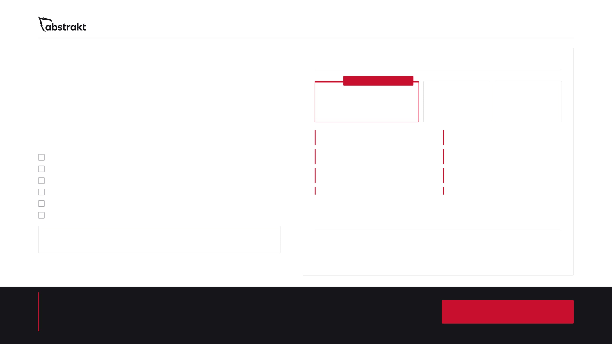
11 / 11 · THE INVESTMENT
You couldn't build this for $1,000 a month.
ABSTRAKT INBOUND SDR
WEB FORM GUARANTEE
$1,000
per month
$1,250
$1,500
We already have.
Starting price
per month
per month
1-year agreement
6-month agreement
Month to month
Up to 100 page website
Managed local SEO and Google Business Profile
BUILD IT YOURSELF
Design and build a website of up to 100 pages
Every business day, a new blog written for your buyers
Up to 3 social platforms every blog is posted to, chosen from six
Write and publish a blog every business day
2 to 3 expert hours a month
Monthly reporting, plus a strategist for your questions
Post every blog to up to 3 social platforms
Run local SEO, your Business Profile and 65+ listings
1 white paper to start
A guide for every product or service
Spend 2 to 3 expert hours a month on technical and page work
Report every month, and have a strategist on hand
$1,427 to $1,708
a month in software alone, before anyone does the work
1-year agreement only: a guarantee of 36 web form submissions for the year. If we miss the number by the end of the year, we work for free until we hit it. You follow up on your own web leads.
Then hire the people: designers, developers, writers, SEO strategists and social media strategists to do the work.
Scope depends on the size of the site, the number of markets and the content you need. Program expectations and commitments are defined in your agreement.
RECOMMENDED: RUN BOTH
Outbound BDR and Inbound SDR together: Outbound BDR from $5,000 + Inbound SDR from $1,000 a month
See how your business shows up online today.
Run My Free AI Visibility Check
→
Outbound BDR starts the conversation, Inbound SDR keeps it going, and the SDRs already on your phones call your website's warm visitors.
Sources and notes: abstraktmg.com/inbound-sdr/presentation/
Notes:
Bring it together. On the left is what it takes to do this yourself: the software alone is $1,427 to $1,708 a month, before anyone designs a page, writes a blog or manages a listing. On the right is the program, starting at $1,000 a month, with every inclusion listed, and the three agreement options: $1,000 a month on a 1-year agreement, $1,250 a month on a 6-month agreement, or $1,500 a month, month to month. Only the 1-year agreement carries the guarantee: 36 web form submissions for the year, and if we miss the number by the end of the year, we work for free until we hit it. They follow up on those web leads themselves. Program expectations and commitments are set out in the agreement. If they run outbound, or should, recommend both: Outbound BDR starts the conversation and Inbound SDR keeps it going, run by one team with every lead in one Results Portal. The starting prices are on the slide. Close with the next step: a visibility review of their site, Business Profile, listings, social pages and what AI tools say about them, then a practical plan.

